Slide 1
Undecidable Problems

Slide 2
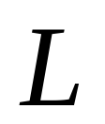


Recall that:
A language is decidable,
if there is a Turing machine (decider)
that accepts and halts on every input string
Decision
on halt
Turing Machine
YES
Accept
Input
string
Decider for
NO
Reject

Slide 3
Undecidable Language
There is no decider for :
there is no Turing Machine
which accepts
and halts on every input string
(the machine may halt and decide for some input strings)

Slide 4
For an undecidable language,
the corresponding problem is
undecidable (unsolvable):
there is no Turing Machine (Algorithm)
that gives an answer (yes or no)
for every input instance
(answer may be given for some input instances)

Slide 5


We have shown before that there are
undecidable languages:
Turing-Acceptable
Decidable
is Turing-Acceptable and undecidable

Slide 6
We will prove that two particular problems
are unsolvable:
Membership problem
Halting problem

Slide 7




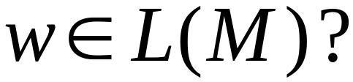
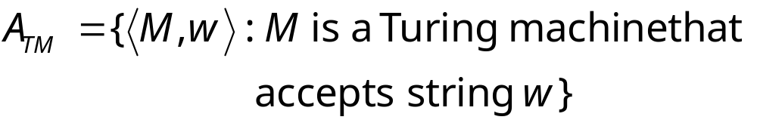
Membership Problem
Input:
Turing Machine
String
Question:
Does accept ?
Corresponding language:

Slide 8
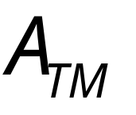
Theorem:
is undecidable
(The membership problem is unsolvable)
Proof:
Basic idea:
We will assume that is decidable;
We will then prove that
every Turing-acceptable language
is also decidable
A contradiction!

Slide 9
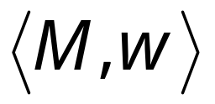
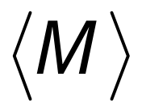


Suppose that is decidable
Input
string
Decider
for
YES
accepts
NO
rejects

Slide 10

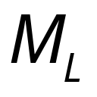
Let be a Turing recognizable language
Let be the Turing Machine that accepts
We will prove that is also decidable:
we will build a decider for

Slide 11

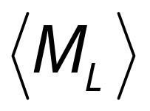

String description of
This is hardwired and copied on the tape next to
input string s, and then the pair is input to H
Decider for
Decider for
YES
accept
machine
(and halt)
accepts ?
NO
reject
Input
string
(and halt)

Slide 12
Therefore,
is decidable
Since is chosen arbitrarily, every Turing-Acceptable language is decidable
But there is a Turing-Acceptable language
which is undecidable
Contradiction!!!!
END OF PROOF

Slide 13
We have shown:
Undecidable
Decidable

Slide 14
We can actually show:
Turing-Acceptable
Decidable

Slide 15
is Turing-Acceptable
Turing machine that accepts :
1. Run on input
2. If accepts
then accept

Slide 16
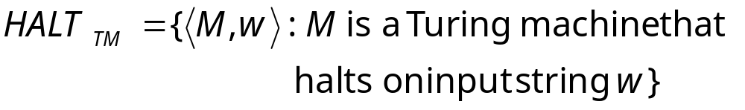
Halting Problem
Input:
Turing Machine
String
Question:
Does halt while
processing input string ?
Corresponding language:

Slide 17
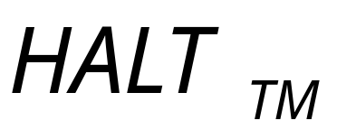
Theorem:
is undecidable
(The halting problem is unsolvable)
Proof:
Basic idea:
Suppose that is decidable;
we will prove that
every Turing-acceptable language
is also decidable
A contradiction!

Slide 18




Suppose that is decidable
Input
string
halts on
input
YES
Decider for
NO
doesn’t halt
on input

Slide 19
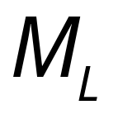
Let be a Turing-Acceptable language
Let be the Turing Machine that accepts
We will prove that is also decidable:
we will build a decider for

Slide 20
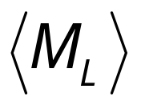

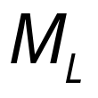

Decider for
Decider for
NO
reject
halts on ?
and halt
YES
Input
string
halts
and accepts
accept
Run
with input
and halt
halts
and rejects
reject
and halt

Slide 21
Therefore,
is decidable
Since is chosen arbitrarily, every Turing-Acceptable language is decidable
But there is a Turing-Acceptable language
which is undecidable
Contradiction!!!!
END OF PROOF

Slide 22
An alternative proof
Theorem:
is undecidable
(The halting problem is unsolvable)
Proof:
Basic idea:
Assume for contradiction that
the halting problem is decidable;
we will obtain a contradiction
using a diagonilization technique

Slide 23

Suppose that is decidable
Input
string
Decider
for
YES
halts on
NO
doesn’t
halt on

Slide 24

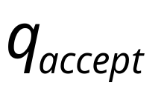

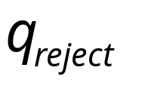
Looking inside
Decider for
YES
Input string:
halts on ?
NO

Slide 25





Construct machine :
Loop forever
YES
halts on ?
NO
If halts on input Then Loop Forever
Else Halt

Slide 26
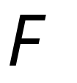

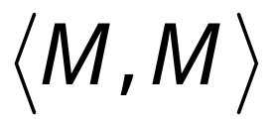

Construct machine :
Copy
on tape
If
halts on input
Then loop forever
Else halt

Slide 27
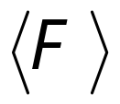
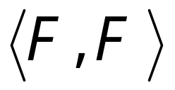

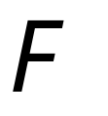

Run with input itself
Copy
on tape
If
halts on input
Then loops forever on input
Else halts on input
CONTRADICTION!!!
END OF PROOF

Slide 28
We have shown:
Undecidable
Decidable

Slide 29
We can actually show:
Turing-Acceptable
Decidable

Slide 30
is Turing-Acceptable
Turing machine that accepts :
1. Run on input
2. If halts on
then accept

Slide 31
We showed:
Turing-Acceptable
Decidable

